Slide 1
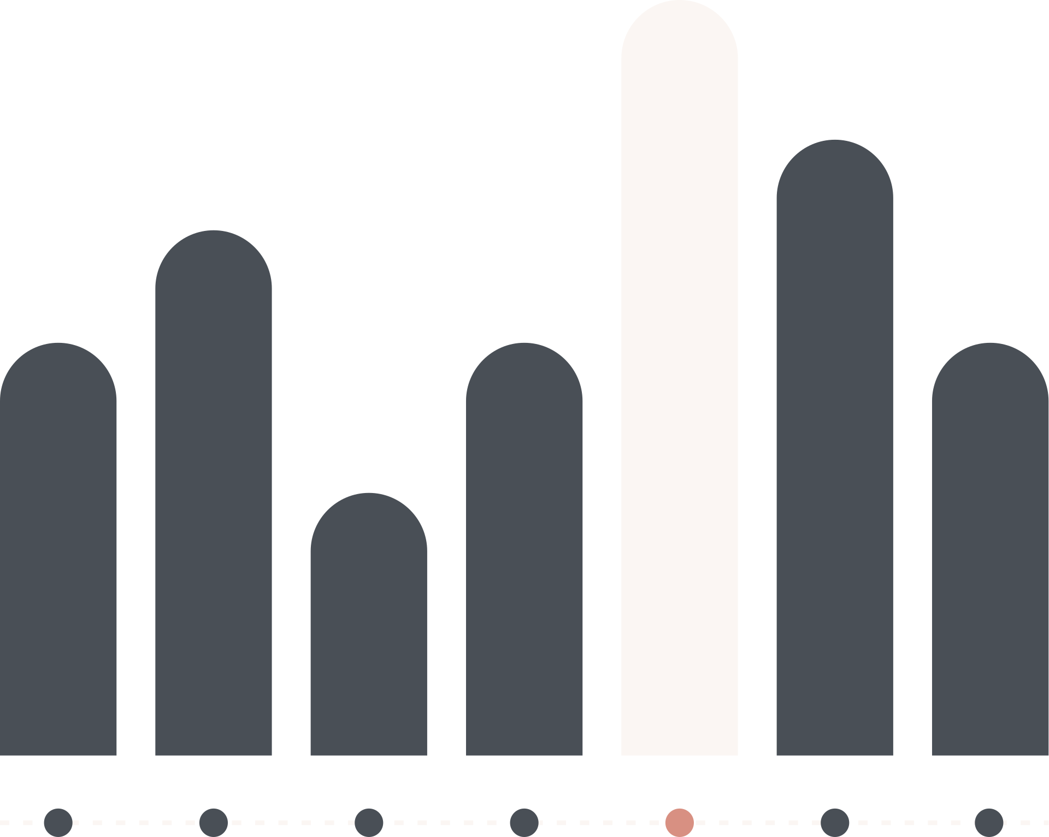

APPLICATIONS OF GRAPH THEORY IN REAL LIFE
BY PARAM THAKKAR

Slide 2

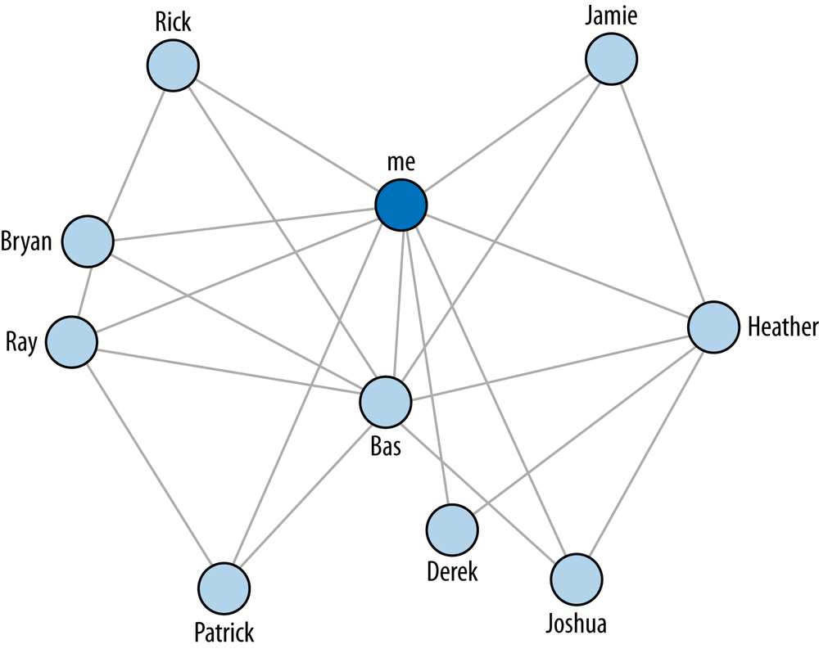
What is Graph theory?
Graph theory is the study of graphs, which are mathematical structures used to model pairwise relations between objects.

Slide 3

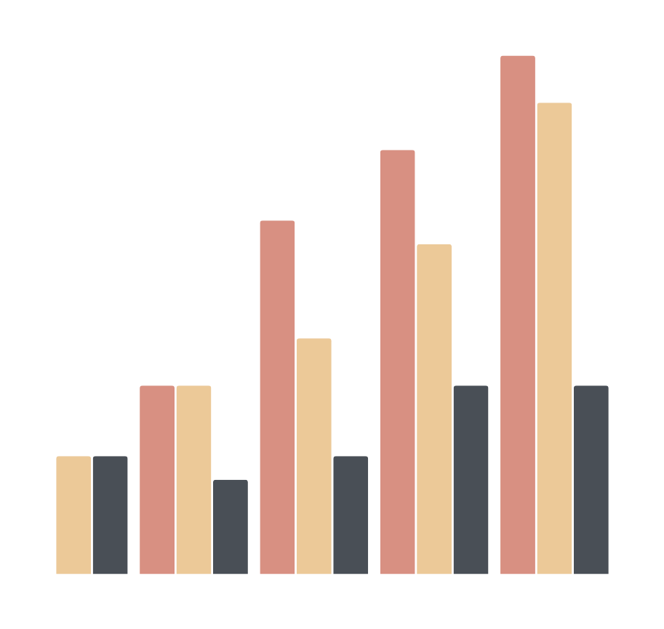
What is a graph?
In graph theory, a graph is a structure amounting to a set of objects in which some pairs of the objects are in some sense "related". The objects correspond to mathematical abstractions called vertices and each of the related pairs of vertices is called an edge.

Slide 4

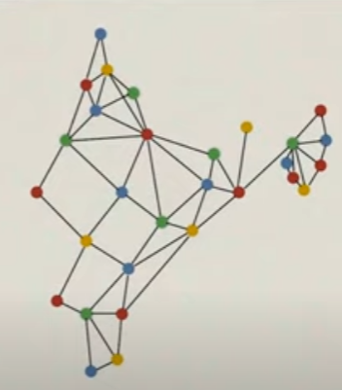
MAP MAKING AND COLOURING
Four clolour theorem:
It is a derived theorem that for any map, four colour are enough to represent areas in the given map

Slide 5
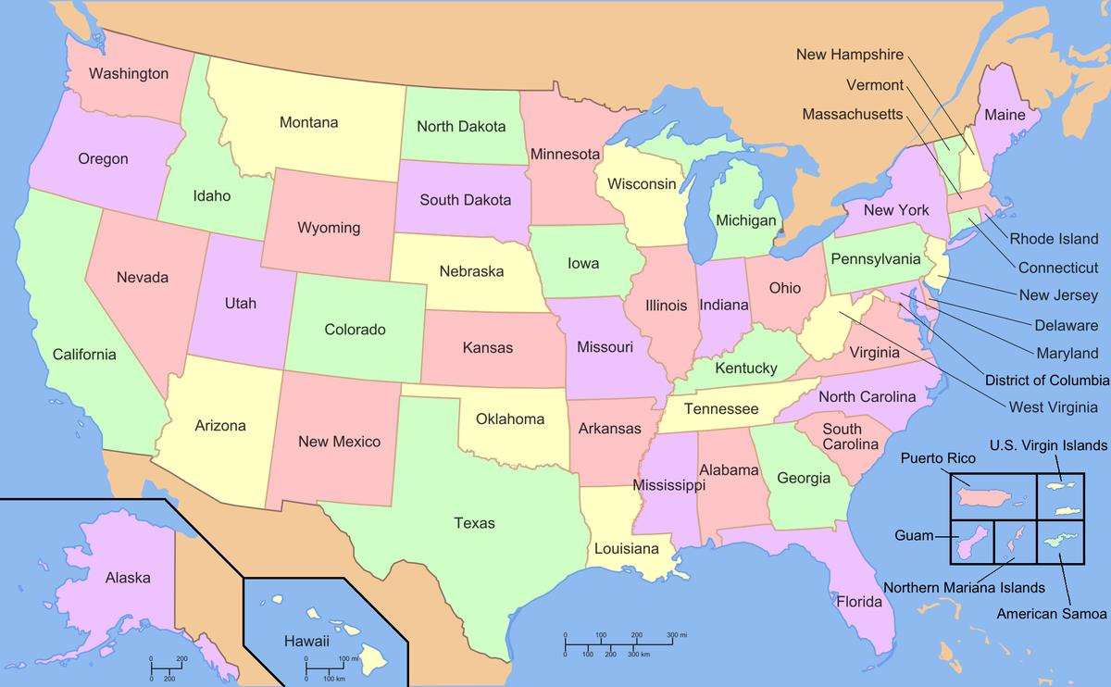

Slide 6
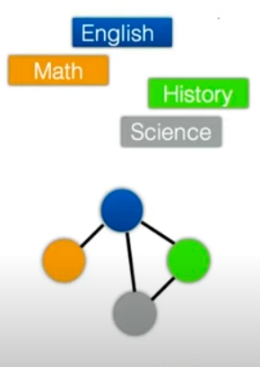
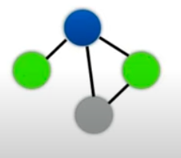
GRAPHS FOR MAKING FOR MIN CLASSES REQUIRED IN A SCHOOL COLLEGE
Edges are overlap in slots.
Consider colours as classrooms.
This way many scheduling problems may be converted to graph problems

Slide 7
BREADTH FIRST SEARCH
BFS is a method for search of paths in a graph by going though breadths, or through all connections at a node.
This method is used for searching a shortest path among the paths in a given graph

Slide 8
DEPTH FIRST SEARCH
In this method we select a node and go till end(depth) to a node and the revert and explore other paths of previous ones.
DFS numbering describes the order in which vertices are explored.

Slide 9
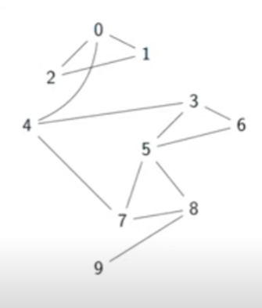

Slide 10
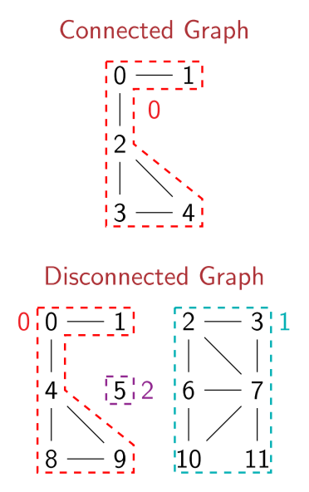
CHECKING CONNECTIVITY
An undirected graph is connected if every vertex is reachable from every other vertex. For identifying connected components in graph:
Start BFS/DFS from vertex 0.
Initialize component no. to 0.
All visited nodes form a connected component.
Assign each visited node component 0.
Similarly, go to an unvisited node.And follow the same procedure.

Slide 11
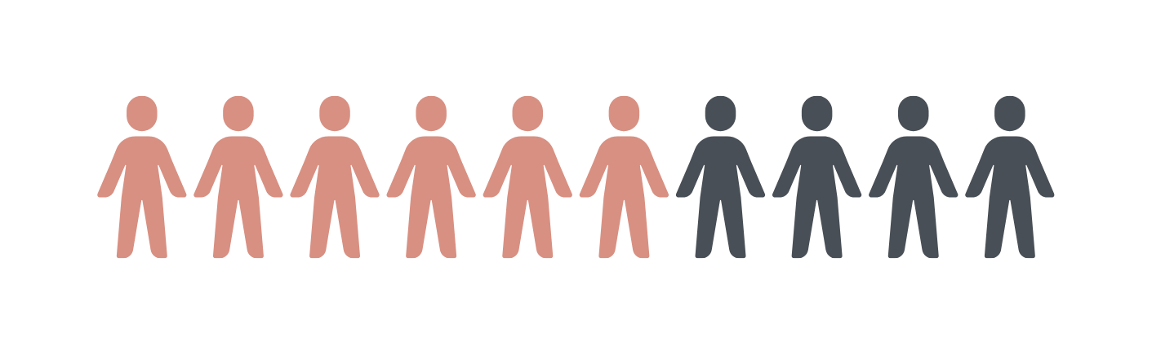

For users this time table may be inconvinient if there are many routes to a single place
a. money
b. time
c. halt required

Slide 12
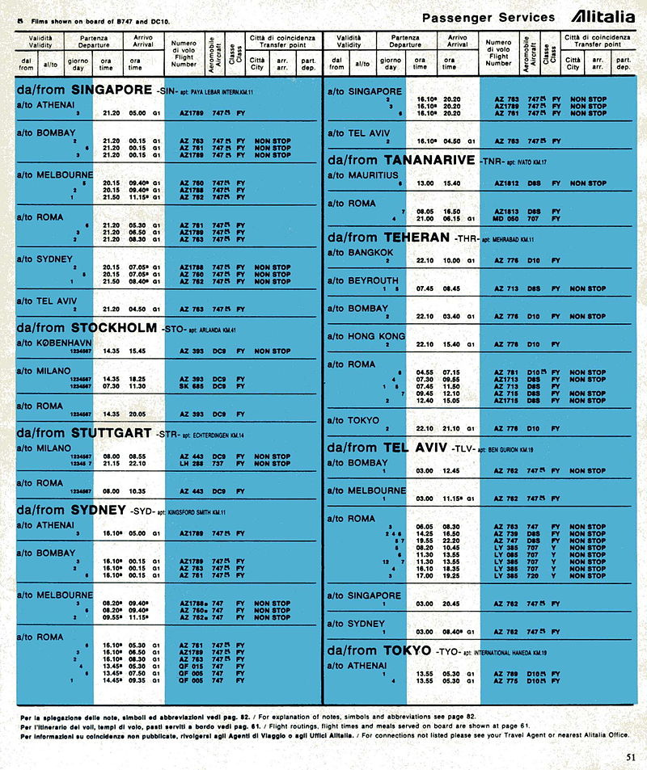

Slide 13
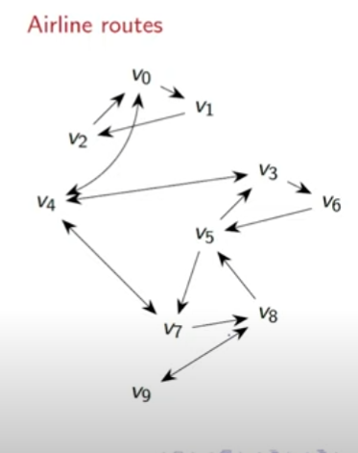
A directed graph

Slide 14
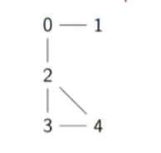
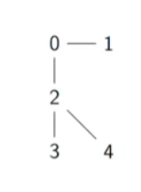
What is a tree?
A tree is a minimally connected graph.
A tree is acyclic. A tree on n vertices has n-1 edges.

Slide 15
DETECTING CYCLES IN THE GRAPH?
A cycle is a path(technically, a walk) that starts and ends at same vertex. Cycle should repeat edges inthe graph. Cycles may repeat vertex. Cycles in a graph can be detected by finding non tree edges as non tree edges generate cycles.
It can be done by making BFS tree or DFS tree.

Slide 16
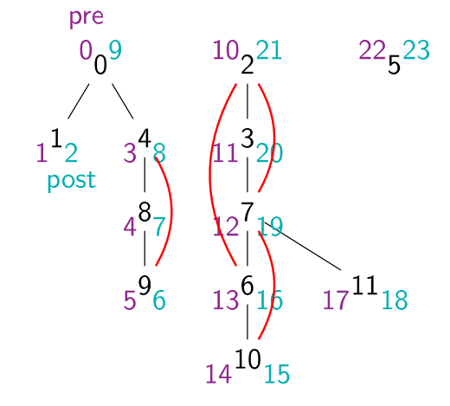
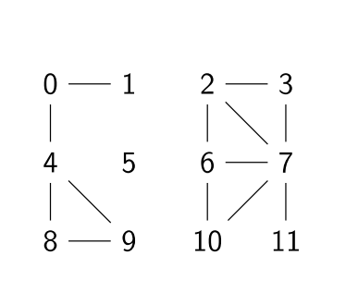
DFS TREE

Slide 17
Thank You

